Slide 1
AWS Quicksight Example

Slide 2
Overview
Experience with AWS Quicksight
eCommerce Analytics Work Study with Lutron
Used Business Review sample dataset provided by AWS

Slide 3
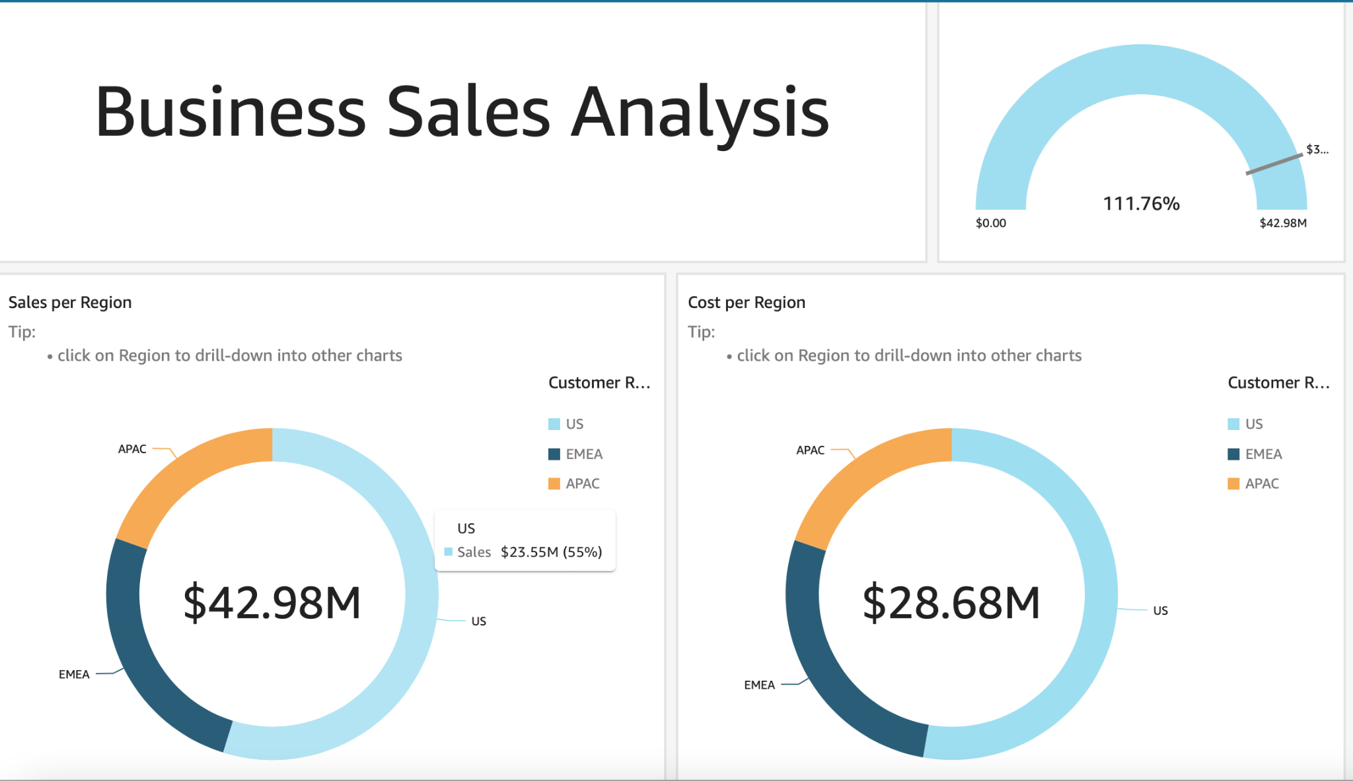

Slide 4
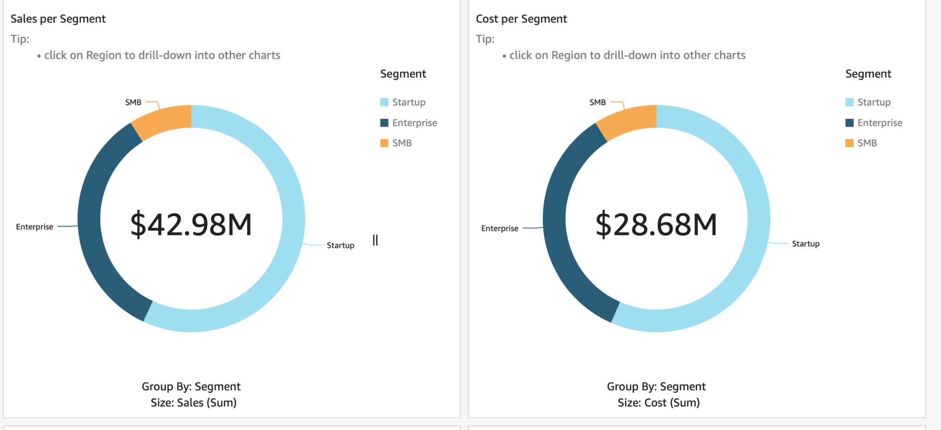

Slide 5
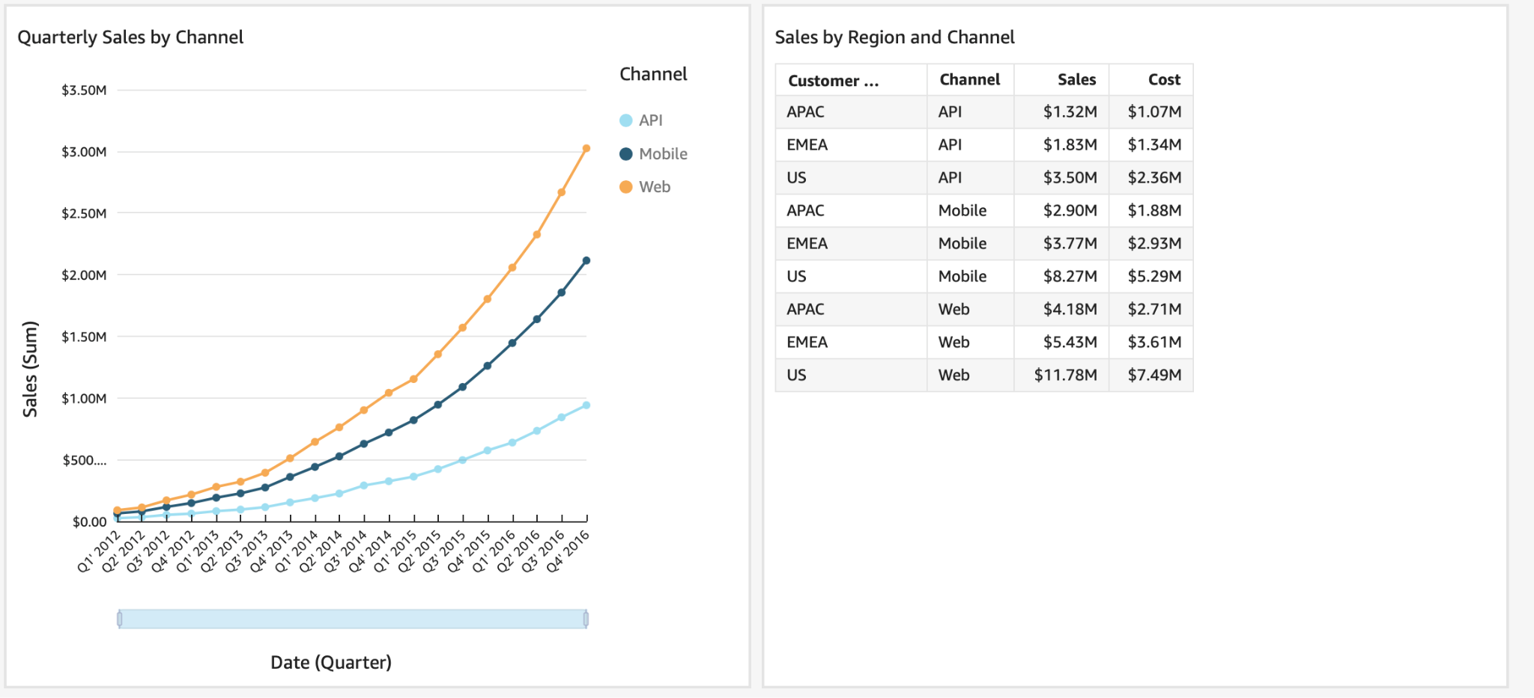

Slide 6
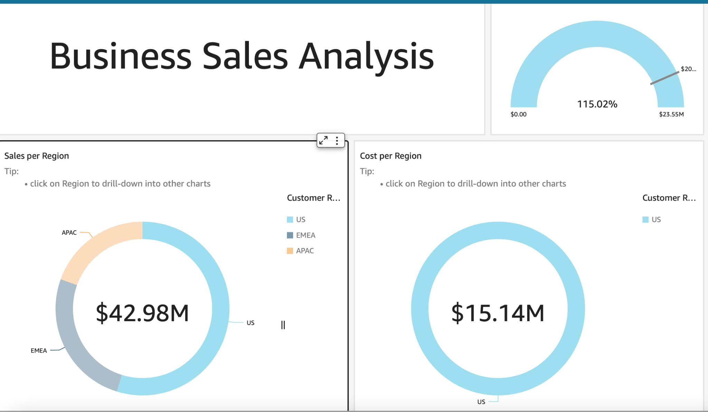
Drill-Down Example

